Slide 1

WHOA THERE!
DELETE THIS SLIDE BEFORE PRESENTING
Copy these slides to your Google Drive Account or Download as a Powerpoint File.
Customize the Wifi info and Introduction slides for your event.
Rehearse this presentation at least 1 - 2 times before the workshop.

Slide 2
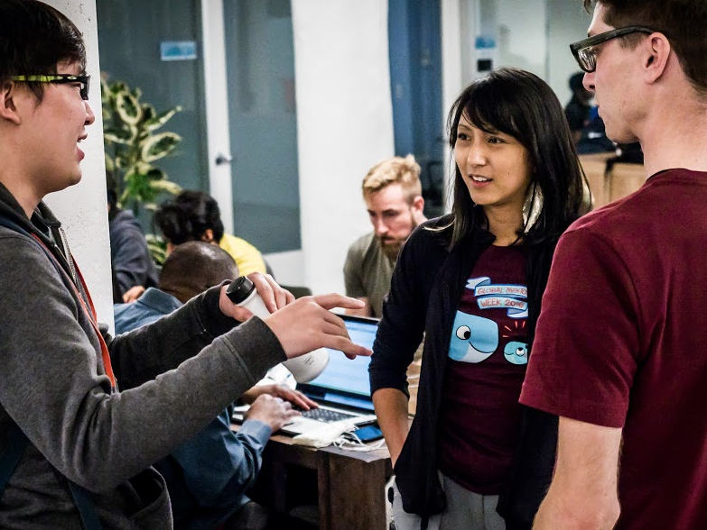
Workshop
Introduction to
Docker

Slide 3


Welcome to
MLH Localhost: Intro to Docker!
Wifi Network:
[Network]
Wifi Password:
[Password]
Event Hashtag:
#MLHLocalhost
Twitter Handle:
@MLHacks
Notes:
What to Edit:
Update this slide to include the wifi information.
What to Say:
Explain how to connect to the wifi.
Encourage participants to Post Photos on Facebook, Twitter or Instagram using #MLHLocalhost
What to Do:
Check that everyone is connected by asking the group to give you a signal if they are connected.

Slide 4

Welcome! My name is
[INSERT YOUR NAME].
[Put your Photo Here]
1
I’m here to lead this session & help you learn something new today!
2
I’m a [LEVEL OF STUDY] at [SCHOOL].
3
My favorite programming language / tool is [LANGUAGE OR TOOL].
Notes:
What to Edit:
Add your name, photo, school info, and favorite programming tool or language.
What to Do:
Make attendees feel welcome by running a short Ice Breaker.
Go around the room and ask each person to answer the following questions:
Who are you?
What year are you in school and what is your major/field of study?
What is your favorite programming language or tool?
You should go first to demonstrate the exercise and introduce yourself

Slide 5
Using your Web Browser,
Open this URL & Fill out the Form:
Afterwards, Check your Email to Find:
1
http://mlhlocal.host/checkin
2
Setup Instructions
An Invite to the MLH Slack
The Code Samples
A Workshop FAQ
These Workshop Slides
More Learning Resources
Notes:
What to Say:
Tell attendees we are going to check them in for the event
Once attendees checkin, they will receive an email with the items listed on the slide
Attendees must checkin to get credit for attending this event
What to Do:
Confirm that everyone has checked in by asking participants to give you a signal when they receive the email.

Slide 6

Our Mission is to Empower Hackers.
65,000+
HACKERS
12,000+
PROJECTS CREATED
3,000+
SCHOOLS
We hope you learn something awesome today!
Find more resources: http://mlh.io/
Notes:
What to Say:
Major League Hacking (MLH) events are meant to bring hackers together so they can learn, build, and share.
Give participants a brief overview of Major League Hacking (MLH).
Tell participants they can learn more at http://mlh.io/
Example Talking Points:
Through Localhost MLH is rethinking technology education to reflect how hackers actually learn and how fast the industry moves.
Here’s some quick facts about MLH:
Each year, MLH supports over 65,000 hackers around the world at events they facilitate
Those students create more than 12,000 amazing projects together
MLH is a global organization that empowers hackers at more than 3,000 schools and growing every day

Slide 7

Introduction to Docker
Table of Contents
1. Intro to MLH Localhost
2. Intro to Docker & Containers
3. Setting up Docker
4. Running your First Container
5. Web Apps with Docker
6. Hosting your Docker Images
7. Quiz & Next Steps

Slide 8

Intro to Docker & Containers
What is Localhost?
Build your local hacker community
Learn skills that are neglected in class
Engage hackers with fun, pre-built activities and workshops
Fill the gap between school and hackathons

Slide 9
Intro to Docker & Containers
Workshop Goals
Understand Docker and Containers
Download and run our first container
Build and run a container from scratch
Upload a container to the Docker Cloud

Slide 10

Intro to Docker & Containers
Share Your Localhost Experience!
We encourage you to take pictures and share your experience!
Tweet pictures @MLHacks and use #MLHLocalhost

Slide 11

Introduction to Docker
Table of Contents
1. Intro to MLH Localhost
2. Intro to Docker & Containers
3. Setting up Docker
4. Running your First Container
5. Web Apps with Docker
6. Hosting your Docker Images
7. Quiz & Next Steps

Slide 12
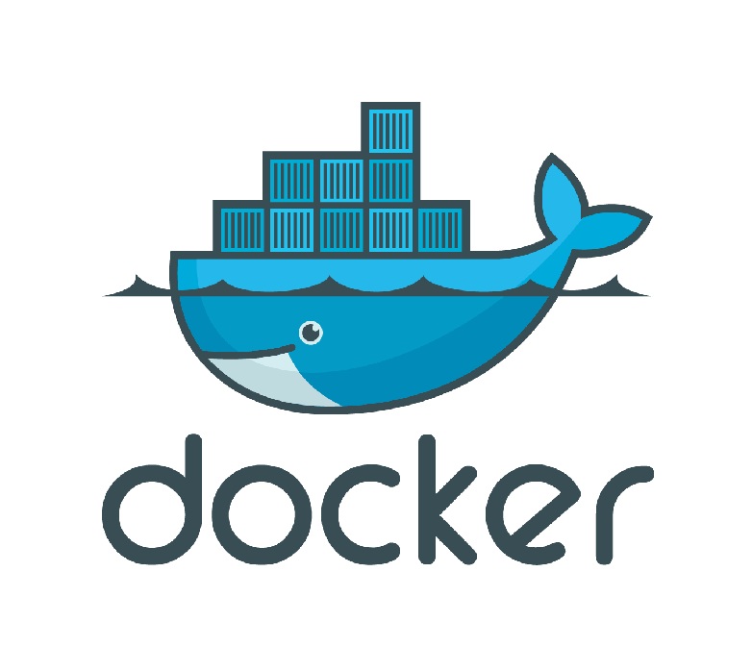
Intro to Docker & Containers
What is Docker?
Docker is a platform that helps
developers build, ship and run any application, in any environment.

Slide 13
Intro to Docker & Containers
What is Docker, Inc?
Sponsor of the Docker Project
Primary contributor and maintainer
7B+ Image Downloads, 3,000+ Contributors, 700,000 Dockerized Applications
Offers containers as a Service
End to end platform for IT Team and a Developers using Docker
Commercial tech support for Docker users
Over 60% of Docker users are using the platform in production

Slide 14
Intro to Docker & Containers
Applications are Changing!
~2000
Today
Loosely Coupled Services
Monolithic
Slow changing
Rapidly updated
Big Servers
Many Small Servers

Slide 15
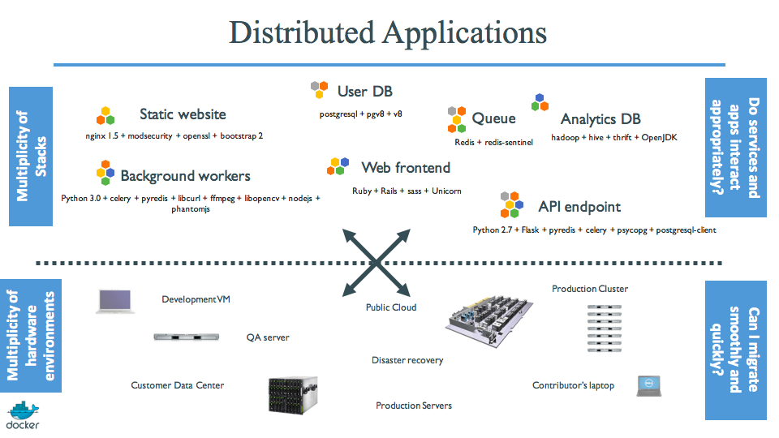
Intro to Docker & Containers

Slide 16

Intro to Docker & Containers
Docker Containers are NOT VMs!
While they share some characteristics, Virtual Machines and Docker Containers are very different under the hood.
Major similarities:
Key Term
Virtual Machine (VM)
A software computer that, like a physical computer, runs an operating system and applications.
Both provide isolated environment for applications to run inside.
Both are easily movable between different hosts.

Slide 17

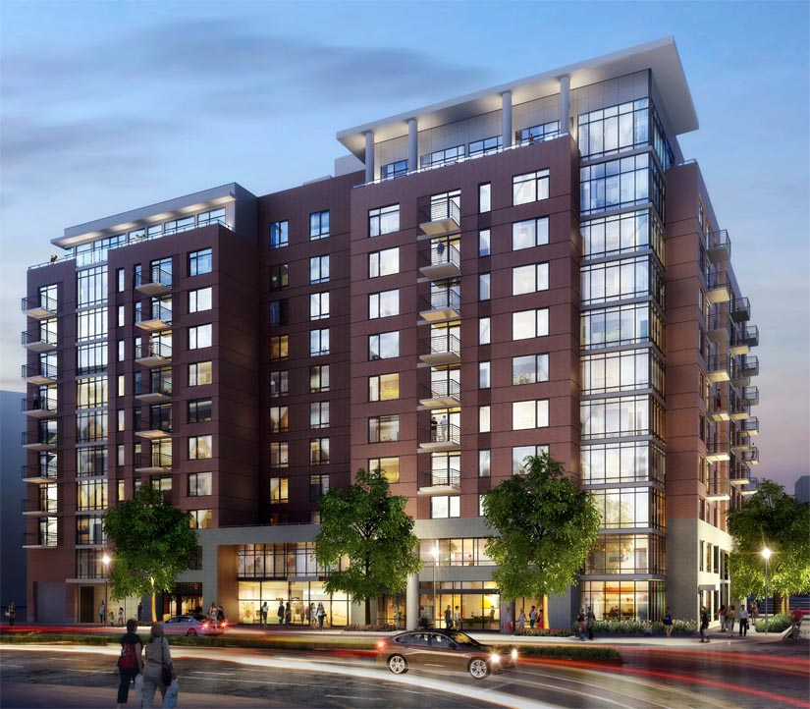
Intro to Docker & Containers
Think Houses vs. Apartments
House = Virtual Machine (VM)
Each VM has a full copy of the OS with dedicated resources.
Each new VM creates a full copy of this environment.
Apartment = Docker Container
Contains exactly what they need to run their application.
Share underlying resources.

Slide 18
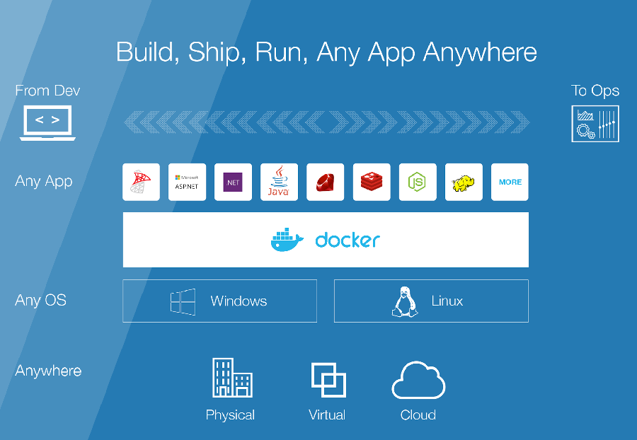
Intro to Docker & Containers
Build, Ship, Run – Any App Anywhere!
An app written on your laptop will run exactly the same anywhere:
Your Friend’s Laptop
Bare Metal Servers
The Cloud
A Raspberry Pi

Slide 19
Introduction to Docker
Table of Contents
1. Intro to MLH Localhost
2. Intro to Docker & Containers
3. Setting up Docker
4. Running your First Container
5. Web Apps with Docker
6. Hosting your Docker Images
7. Quiz & Next Steps

Slide 20
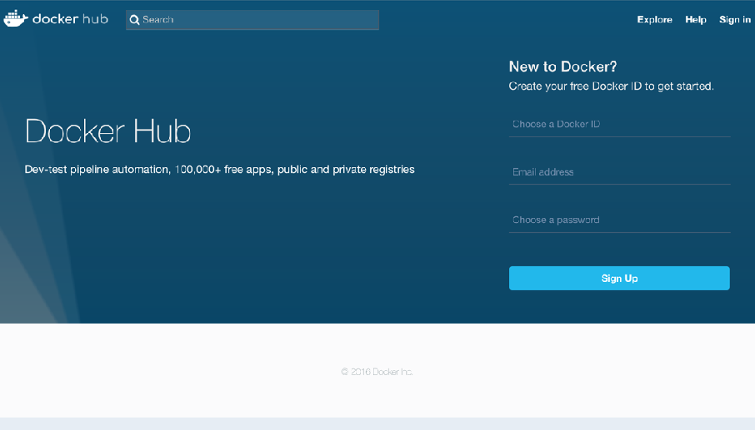
Setting up Docker
Meet Docker Hub!
What is Docker Hub?
Docker Hub is a registry of Docker images. You can think of the registry as a directory of all available Docker images. You'll be using this later in this tutorial.
http://mlhlocal.host/docker-hub

Slide 21
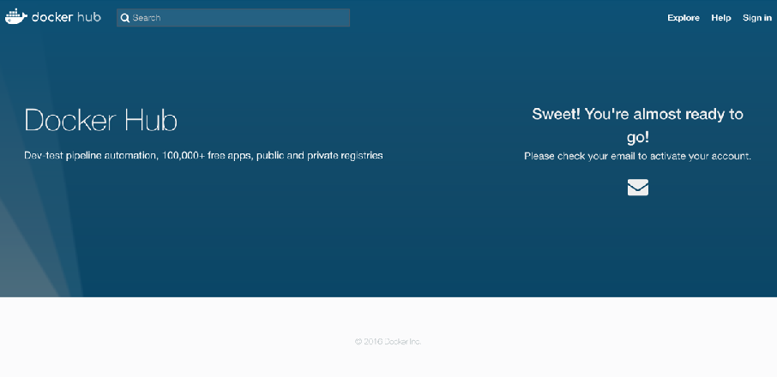
Setting up Docker
Sign up for a Docker ID
Fill out the Form & Verify your Email Address.
Enter your email and chose a Docker ID and password for your account. You’ll be asked to verify your email address before being able to log in though. Do that now!
http://mlhlocal.host/docker-hub
Note: Remember your Docker ID, you’ll need it later!

Slide 22
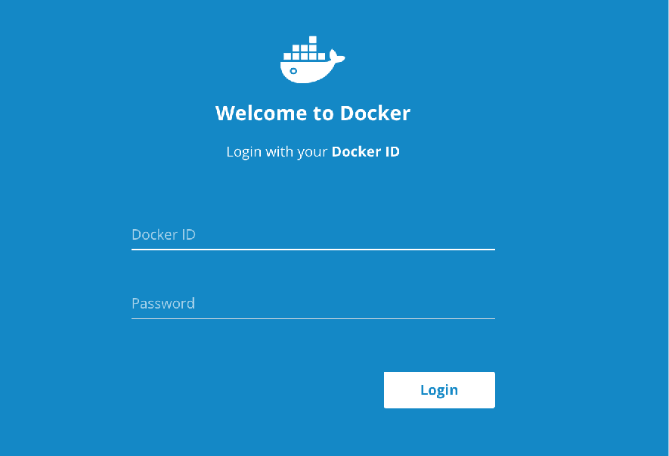
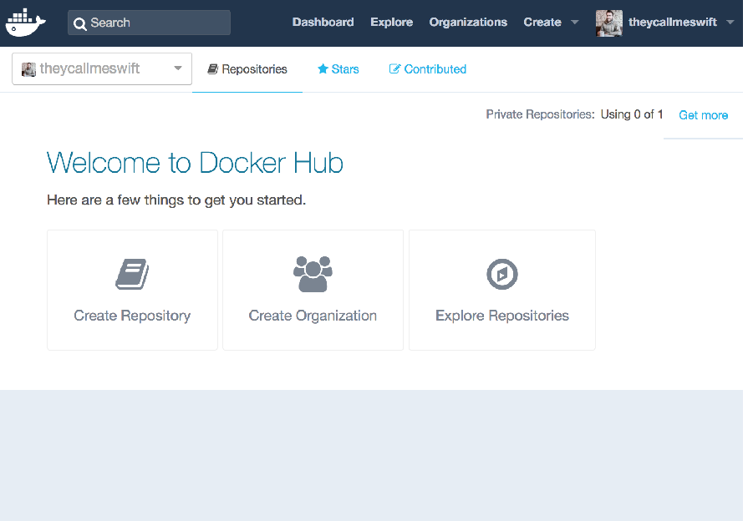
Setting Up Docker
Login Using your Docker ID
Follow the link you got from Docker Hub’s email to verify your account. You can now login using the Docker ID and password you picked!

Slide 23
Setting up Docker
Let’s install Docker on your Machine!
Visit the Appropriate Guide:
Visit the link for the type of computer you have:
Mac - http://mlhlocal.host/docker-mac
Linux - http://mlhlocal.host/docker-linux
Windows (10 Pro Edition only) - http://mlhlocal.host/docker-windows
Stuck? Raise your hand & someone will come help you!

Slide 24
Setting up Docker
Test your Installation
Once you are done installing Docker, test your Docker installation by running the following in a command prompt (Terminal, PowerShell, etc):
$ docker run hello-world
Hello from Docker!
This message shows that your installation appears to be working correctly.
To generate this message, Docker took the following steps:
1. The Docker client contacted the Docker daemon.
2. The Docker daemon pulled the "hello-world" image from the Docker Hub.
3. The Docker daemon created a new container from that image which runs the
executable that produces the output you are currently reading.
4. The Docker daemon streamed that output to the Docker client, which sent it
to your terminal.
To try something more ambitious, you can run an Ubuntu container with:
$ docker run -it ubuntu bash
…

Slide 25
Introduction to Docker
Table of Contents
1. Intro to MLH Localhost
2. Intro to Docker & Containers
3. Setting up Docker
4. Running your First Container
5. Web Apps with Docker
6. Hosting your Docker Images
7. Quiz & Next Steps

Slide 26

Running your First Docker Container
Let’s Run our First Container!
We’re going to run Alpine Linux!
Alpine Linux is a lightweight Linux distribution.
We can get a Docker Image containing Alpine Linux from Docker Hub.

Slide 27
Running your First Docker Container
Pull the Alpine Linux Image
The pull command fetches the Alpine Linux image from the
Docker registry (Docker Hub) and saves it in our system.
$ docker pull alpine
Using default tag: latest
latest: Pulling from library/alpine
0a8490d0dfd3: Pull complete
Digest: sha256:dfbd4a3a8ebca874ebd2474f044a0b33600d4523d03b0df76e5c5986cb02d7e8
Status: Downloaded newer image for alpine:latest

Slide 28
Running your First Docker Container
Review the List of Local Docker Images
You can use the docker images command to
see a list of all images on your system.
$ docker images
REPOSITORY TAG IMAGE ID CREATED SIZE
alpine latest 88e169ea8f46 4 weeks ago 3.98 MB

Slide 29
Running your First Docker Container
Run your First Docker Container!
Let's now run a Docker container based on this image.
$ docker run alpine ls -l
total 52
drwxr-xr-x 2 root root 4096 Dec 26 21:32 bin
drwxr-xr-x 5 root root 340 Jan 25 22:26 dev
drwxr-xr-x 14 root root 4096 Jan 25 22:26 etc
drwxr-xr-x 2 root root 4096 Dec 26 21:32 home
drwxr-xr-x 5 root root 4096 Dec 26 21:32 lib
drwxr-xr-x 5 root root 4096 Dec 26 21:32 media
drwxr-xr-x 2 root root 4096 Dec 26 21:32 mnt
dr-xr-xr-x 144 root root 0 Jan 25 22:26 proc
drwx------ 2 root root 4096 Dec 26 21:32 root
drwxr-xr-x 2 root root 4096 Dec 26 21:32 run
drwxr-xr-x 2 root root 4096 Dec 26 21:32 sbin
drwxr-xr-x 2 root root 4096 Dec 26 21:32 srv
dr-xr-xr-x 12 root root 0 Jan 25 22:26 sys
drwxrwxrwt 2 root root 4096 Dec 26 21:32 tmp
drwxr-xr-x 7 root root 4096 Dec 26 21:32 usr
drwxr-xr-x 12 root root 4096 Dec 26 21:32 var

Slide 30
Running your First Docker Container
Wow! What just Happened?
$ docker run alpine ls -l
Locate the requested image.
Create a new container using the requested image.
Execute the provided command in the container.

Slide 31
Running your First Docker Container
Let’s Try Some Other Commands!
What other Unix commands can you run? Try any of these
or some of your personal favorites!
$ docker run alpine cal
$ docker run alpine echo "hello World"
$ docker run alpine pwd
$ docker run alpine id -u -n

Slide 32

Running your First Docker Container
Containers are FAST!
The commands we run execute almost immediately!
Each time the Docker client runs the command in our container and then exits.
Booting up a virtual machine, running a command, and then killing it would take forever!

Slide 33
Running your First Docker Container
Let’s get Interactive!
All of our commands have exited immediately after running them.
How do we run a container interactively?
$ docker run -it alpine /bin/sh
/ # uname -a
Linux 1b579b6024b4 4.9.4-moby #1 SMP Wed Jan 18 17:04:43 UTC 2017 x86_64 Linux
/ # ls
bin dev etc home lib media mnt proc root run sbin srv sys tmp usr var
/ # cd usr/
/usr # ls
bin lib local sbin share
/ # exit

Slide 34
Introduction to Docker
Table of Contents
1. Intro to MLH Localhost
2. Intro to Docker & Containers
3. Setting up Docker
4. Running your First Container
5. Web Apps with Docker
6. Hosting your Docker Images
7. Quiz & Next Steps

Slide 35

Web Apps with Docker
Let’s Run a Web App with Docker!
Time for the real stuff – deploying web applications with Docker!
We’re going to make a website that looks like this:

Slide 36

Web Apps with Docker
Find the Source Code on GitHub
If you’re interested, you can find the code for the website we’re going to run on GitHub:
http://mlhlocal.host/docker-static-site-source
or see the site running live on Heroku:
http://mlhlocal.host/docker-static-site

Slide 37
Web Apps with Docker
Let’s Run the Image from Docker Hub.
We created an image on Docker Hub that contains the
code under `mlhacks/docker-static-site`.
$ docker run --name static-site -d -p 8888:80 mlhacks/docker-static-site
Unable to find image ‘mlhacks/docker-static-site:latest' locally
latest: Pulling from mlhacks/docker-static-site
fdd5d7827f33: Pull complete
a3ed95caeb02: Pull complete
716f7a5f3082: Pull complete
7b10f03a0309: Pull complete
aff3ab7e9c39: Pull complete
Digest: sha256:41b286105f913fb7a5fbdce28d48bc80f1c77e3c4ce1b8280f28129ae0e94e9e
Status: Downloaded newer image for mlhacks/docker-static-site:latest
1fd4d53f64d48534ad7db3f8bfa8b745977aab87161f70da56b4672e9e0868eb
Note: The -d flag enables detached mode, which detaches the
running container from the terminal. The -p flag to publish the website on port 8888.

Slide 38
Web Apps with Docker
So, What just Happened?
Notice that we didn’t run docker pull before we ran the new image. Here’s what happened:
$ docker run --name static-site -d -p 8888:80 mlhacks/docker-static-site
Locate the requested image (not found locally in this case).
Download this missing image from Docker Hub.
Create a new container using the requested image .
Name the container using the --name parameter.
Run it in the background (detached) and return to the prompt.
Expose port 8888.

Slide 39
Web Apps with Docker
Try Visiting your Website!
Head over to the following URL and you should see the website below:
http://localhost:8888

Slide 40
Web Apps with Docker
How do we Stop a Detached Image?
We can use docker stop and docker rm to stop and remove a
Docker Image that is running in the background.
$ docker ps
CONTAINER ID IMAGE COMMAND CREATED
f3ade96bc4ff mlhacks/static-site "/bin/sh -c 'cd /u..." 2 hours ago
STATUS PORTS NAMES
Up 2 hours 80/tcp, 443/tcp competent_bartik
$ docker stop f3ade96bc4ff
f3ade96bc4ff
$ docker rm f3ade96bc4ff
f3ade96bc4ff
Note: The example above provides the CONTAINER ID on our system; you should use the value that you see in your terminal.

Slide 41
Web Apps with Docker
Let’s Clean Up!
Since we started this process with a name, we don’t need to use
docker ps to figure out the ID.
$ docker stop static-site
static-site
$ docker rm static-site
static-site

Slide 42
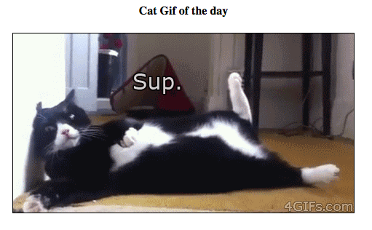

Web Apps with Docker
Let’s Make a Docker Image!
We’ve run other people’s images so far, how do we create our own?
Let’s find out by creating an app that displays cat photos.
Cat GIFs Courtesy of

Slide 43
Web Apps with Docker
Download the Source Code on GitHub
You can find the code for the website we’re going to run on GitHub. Download it from here:
http://mlhlocal.host/docker-flask-source
or see the site running live on Heroku:
http://mlhlocal.host/docker-flask

Slide 44

Web Apps with Docker
We’re Going to Use Python + Flask!
Flask is a Framework for Python
Makes it easy to build web applications by providing a standard set of tools.
You don’t need to know flask to understand this example.

Slide 45
Web Apps with Docker
app.py
1 from flask import Flask, render_template
2 import random
3
4 app = Flask(__name__)
5
6 images = [
7 “http://bit.ly/docker-cat-1",
8 "http://bit.ly/docker-cat-2",
9 "http://bit.ly/docker-cat-3"
10 ]
11
12 @app.route('/')
13 def index():
14 url = random.choice(images)
15 return render_template("index.html", url=url)
16
17 if __name__ == "__main__":
18 app.run(host="0.0.0.0")
Currently Editing: app.py

Slide 46
Web Apps with Docker
requirements.txt
1 Flask==0.10.1
Currently Editing: requirements.txt

Slide 47
Web Apps with Docker
templates/index.html
1 <html>
2 <head>
3 <style type="text/css">
4 .container {
5 text-align: center;
6 }
7 </style>
8 </head>
9 <body>
10 <div class="container">
11 <h4>Cat GIF of the Day!</h4>
12 <img src="{{url}}" />
13 </div>
14 </body>
15 </html>
Currently Editing: templates/index.html

Slide 48
Web Apps with Docker
Dockerfile
1 # our base image
2 FROM alpine:3.5
3
4 # Install python and pip
5 RUN apk add --update py2-pip
6
7 # install Python modules needed by the Python app
8 COPY requirements.txt /usr/src/app/
9 RUN pip install --no-cache-dir -r /usr/src/app/requirements.txt
10
11 # copy files required for the app to run
12 COPY app.py /usr/src/app/
13 COPY templates/index.html /usr/src/app/templates/
14
15 # tell the port number the container should expose
16 EXPOSE 5000
17
18 # run the application
19 CMD ["python", "/usr/src/app/app.py"]
Currently Editing: Dockerfile

Slide 49
Web Apps with Docker
Build the Docker Image
Now that you have your Dockerfile, you can build your image.
The docker build command does this:
$ docker build -t mlhacks/flask-example .
Sending build context to Docker daemon 7.168 kB
Step 1/8 : FROM alpine:3.5
---> 88e169ea8f46
Step 2/8 : RUN apk add --update py2-pip
---> Using cache
---> 092f0d63efa5
Step 3/8 : COPY requirements.txt /usr/src/app/
---> 6698c1620af9
Removing intermediate container 1cf339c62124
…
Step 8/8 : CMD python /usr/src/app/app.py
---> Running in db811e85de07
---> 58358996ea4c
Removing intermediate container db811e85de07
Successfully built 58358996ea4c

Slide 50
Web Apps with Docker
Run your Docker Image
Use the docker run command to run the image we just built.
Replace mlhacks with your Docker ID.
$ docker run -p 8888:5000 mlhacks/flask-example
* Running on http://0.0.0.0:5000/ (Press CTRL+C to quit)
Head over to the following URL to see your handy work:
http://localhost:8888

Slide 51
Web Apps with Docker
Try Visiting your Website!
Head over to the following URL and you should see the website below:
http://localhost:8888
Cat GIFs Courtesy of

Slide 52
Introduction to Docker
Table of Contents
1. Intro to MLH Localhost
2. Intro to Docker & Containers
3. Setting up Docker
4. Running your First Container
5. Web Apps with Docker
6. Hosting your Docker Images
7. Quiz & Next Steps

Slide 53
Hosting your Docker Images
Host your Images on Docker Hub
Now that you’ve created you first Docker Image, you can publish it on Docker Hub for later use.

Slide 54
Hosting your Docker Images
Login to your Docker Hub Account
In order to publish your image on Docker Hub, you need to
login on the command line.
$ docker login
Login with your Docker ID to push and pull images from Docker Hub. If you don't have a Docker ID, head over to https://hub.docker.com to create one.
Username: mlhacks
Password:
Login Succeeded
Note: Replace “mlhacks” with the Docker ID you created at the beginning of the workshop. Your password will be hidden when you type it out.

Slide 55
Hosting your Docker Images
Push your Image to Docker Hub
We can use the docker push command to publish an image we have
locally on Docker Hub for later use.
$ docker push mlhacks/flask-example
The push refers to a repository [docker.io/mlhacks/flask-example]
efa6c37d0ae8: Pushed
779aa7159987: Pushed
b9fb8f60d4f6: Pushed
a6d6947400ab: Pushed
1f8090c7aa46: Pushed
1f8090c7aa46: Pushed
latest: digest: sha256:512526fbdd5fc34d7b9f61712f114e7453ab01c5629e3f5e0cc35ed864daf size: 1572
Note: Replace “mlhacks” with the Docker ID you
created at the beginning of the workshop.

Slide 56
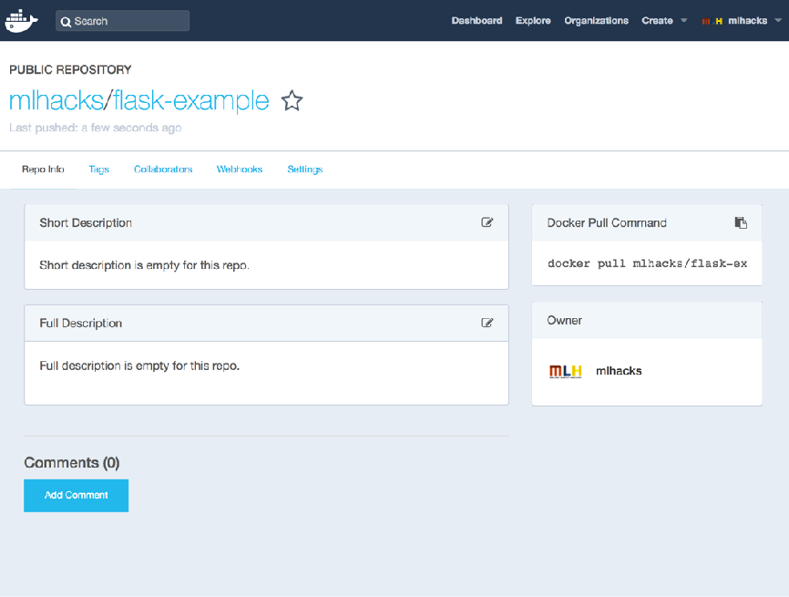
Hosting your Docker Images
Find your Image on Docker Hub
Log into your Docker Hub Account to see your Image!
You just published your first Docker Image on the Docker Hub Registry. Other developers can download and install your image by using docker run now!
http://mlhlocal.host/docker-hub

Slide 57





Hosting your Docker Images
Deploy your App on Docker Cloud!
Docker Cloud is the best way to deploy and manage Dockerized applications.
Makes it easy for new Docker users to manage and deploy everything form single container apps to distributed microservices stacks.
Deploy to any cloud or on-premise infrastructure.
Note: As an MLH student hacker, you get $100 in credit from AWS!
http://hackp.ac/aws2017

Slide 58
Introduction to Docker
Table of Contents
1. Intro to MLH Localhost
2. Intro to Docker & Containers
3. Setting up Docker
4. Running your First Container
5. Web Apps with Docker
6. Hosting your Docker Images
7. Quiz & Next Steps

Slide 59
What did you learn today?
We created a fun quiz to test your knowledge and see what you learned from this workshop.
http://mlhlocal.host/quiz
Notes:
What to Say:
Ok. It’s time to see what you learned today. Open up the following URL in your browser to complete the quiz and a short survey about this workshop
Once you finish, raise your hand and let me know what your score was!
What to Do:
Walk around and make sure participants are able to take the quiz.
Make sure everyone completes the quiz and survey. We use this information to improve the workshop for future hackers!

Slide 60

Quiz & Next Steps
Welcome to the Docker Student Community!
http://mlhlocal.host/docker-students
Sign up & receive the following:
Access to our free Docker Student Kit!
Latest product updates and release notes
Invitations and promo codes just for students for Docker community events
Ability to participate in raffles for Docker Swag
Chance to get priority access to product betas
Opportunity to become a Docker Campus Ambassador
A listing on the Docker Student Community Directory without sharing your email (built in direct messaging system)
Access to the Docker Community Slack

Slide 61

Quiz & Next Steps
Join the Docker Community Slack Team!
An instant messenger to communicate easily with the Docker Team and members of the Docker Community
Join channels centered around interest in specific Docker-centric projects / topics, locations, languages etc.
#docker-students: a dedicated channel to converse with other students from all over the world about Docker

Slide 62
Quiz & Next Steps
Become a Docker Campus Ambassador
Are you an intermediate to advanced Docker user? Are you a leader on campus with a knack for bringing people together? Do you want to help your peers learn Docker?Become a Docker Campus Ambassador!
Benefits include:
Technical & professional training directly from the Docker team
Privileged access to latest Docker editions
Free tickets to community events like DockerCon
Lots of swag!
mlhlocal.host/docker-ambassador

Slide 63

Quiz & Next Steps
Join us at DockerCon 2017!
Docker is hosting DockerCon on April 17th - 20th in Austin, Texas.
Save the date and join the Docker Community there!

Slide 64
Workshop
Introduction to
Docker

